Slide 1

ITS30705 CHAPTER 9: recursion

Slide 2
Learning outcome
Student should be able to:
Understand on the recursion and recursion backtracking method
Implement recursion and recursion backtracking method to solve problem

Slide 3

EXERCISE
How many students are behind you?
You have poor vision, so you can only the people right next to you. So, you can’t just look back and count. But you are allowed to ask questions next to you.
How can we solve this problem? (recursively)

Slide 4


THE IDEA
Hey neighbor, help me out!
Recursion is all about breaking a big problem into smaller occurrences of that same problem.
Each person can solve a small part of the problem.
What is a small version of the problem that would be easy to answer?
What information from a neighbor might help me?
Hey neighbor, help me out!
Hey neighbor, help me out!

Slide 5
Recursive algorithm
3. Hey neighbor, help me out!
Number of people behind me:
If there is someone behind me, ask him/her how many people behind him/her
When they respond with a value N, then I will answer N + 1
If there is nobody behind me, I will answer 0
2. Hey neighbor, help me out!
1. Hey neighbor, help me out!

Slide 6
recursion
Recursion: The definition of an operation in terms of itself.
Solving a problem using recursion depends on solving smaller occurrences of the same problem.
Recursive Programming: Writing functions that call themselves to solve problems recursively.
An equally powerful substitute for iteration (loops)
Particularly well-suited to solving certain types of problems

Slide 7
Why learn recursion?
“Cultural experience” – think differently about problems
Solves some problems more naturally than iteration
Lead to elegant, simplistic, short code (when used well)
Many programming languages use recursion exclusively (no loops)

Slide 8
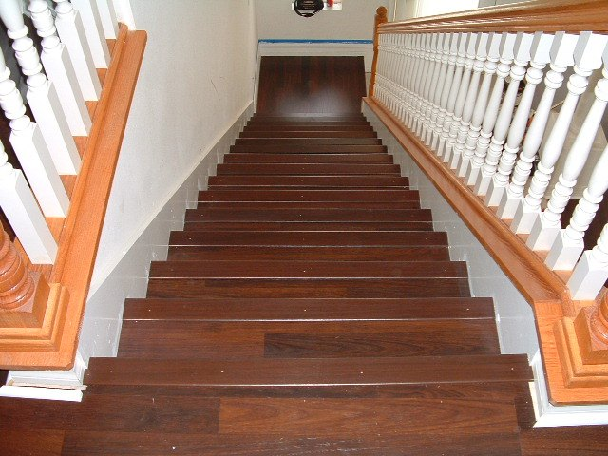
Getting downstairs
Need to know two things:
Getting down one stair
Recognizing the bottom
Most code will look like:
if simplest case:
compute and return solution
else:
divide into similar subproblem(s)
solve each subproblem recursively
assemble the overall solution

Slide 9
Recursion and cases
Every recursive algorithm involves at least 2 cases:
Base case: A simple occurrence that can be answered directly
Recursive case: A more complex occurrence of the problem that cannot be directly answered but can be described in terms of smaller occurrences of the same problem.
Some recursive algorithms have more than one base or recursive case, but all have at least one of each.
A crucial part of recursive programming is identifying these cases

Slide 10
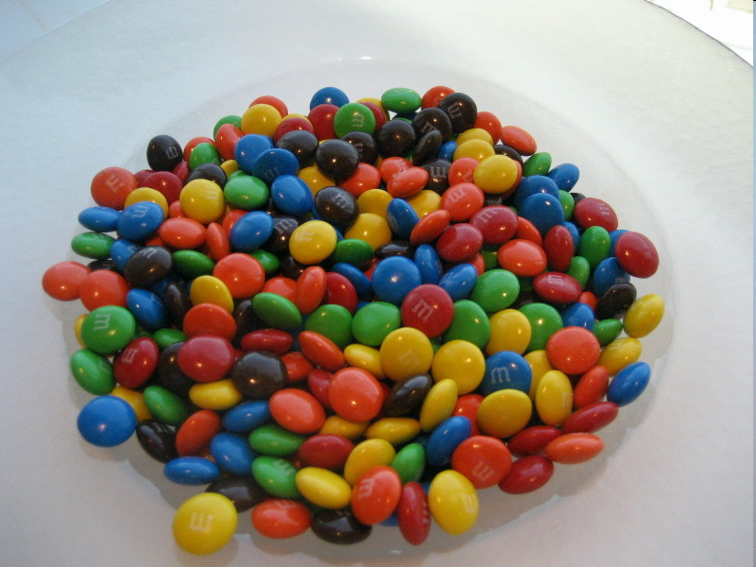
ANOTHER RECURSIVE TASK
How can we remove exactly half of the M&M's in a large bowl, without dumping them all out or being able to count them?
What if multiple people help with solving the problem? Can each person do a small part of the work?
What is a number of M&M's that it is easy to double, even if you can't count?
(What is a "base case"?)

Slide 11
RECURSION IN PYTHON
Consider the following function to print a line of * characters:
# Prints a line containing the given number of stars.
# Precondition: n >= 0
def print_stars(n):
for i in range(0, n):
print("*", end='')
print() # end the line of output

Slide 12
A BASIC CASE
What are the cases to consider?
What is a very easy number of stars to print without a loop?
def print_stars(n):
if n == 1:
# base case; just print one star
print("*", end='')
else:
...

Slide 13
Handling more cases
Handling additional cases, with no loops (in a bad way):
def print_stars(n):
if n == 1:
# base case; just print one star
print("*", end='')
elif end='')
pn == 2:
print("*", rint("*", end='')
elif n == 3:
print("*", end='')
print("*", end='')
print("*", end='')
elif n == 4:
print("*", end='')
print("*", end='')
print("*", end='')
print("*", end='')
else: ...

Slide 14
HANDLING MORE CASES
Taking advantage of the repeated pattern (somewhat better):
def print_stars(n):
if n == 1:
# base case; just print one star
print("*")
elif n == 2:
print("*", end='')
print_stars(1) # prints "*"
elif n == 3:
print("*", end='')
print_stars(2) # prints "**"
elif n == 4:
print("*", end='')
print_stars(3) # prints "***"
else: ...

Slide 15
Using recursion properly
Condensing the recursive cases into a single case:
def print_stars(n):
if n == 1:
# base case; just print one star
print("*")
else:
# recursive case; print one more star
print("*", end='')
print_stars(n - 1)

Slide 16
RECURSION ZEN
The real, even simpler, base case is an n of 0 and 1:
def print_stars(n):
if n == 0:
# base case; just end the line of output
print()
else:
# recursive case; print one more star
print("*", end='')
print_stars(n - 1)
Recursion Zen: The art of properly identifying the best set of cases for a recursive algorithm and expressing them elegently

Slide 17
Recursive tracing EXAMPLE #1
Consider the following recursive function:
def mystery(n):
if n < 10:
return n
else:
a = n // 10
b = n % 10
return mystery(a + b)
What is the result of the following call?
mystery(648)

Slide 18
recursive trace EXAMPLE #1
mystery(648):
a = 648 // 10 # 64
b = 648 % 10 # 8
return mystery(a + b) # mystery(72)
mystery(72):
a = 72 // 10 # 7
b = 72 % 10 # 2
return mystery(a + b) # mystery(9)
mystery(9):
return 9

Slide 19
Recursive tracing EXAMPLE #2
Consider the following recursive function:
def mystery(n):
if n < 10:
return (10 * n) + n
else:
a = mystery(n // 10)
b = mystery(n % 10)
return (100 * a) + b
What is the result of the following call?
mystery(348)

Slide 20
Recursive trace EXAMPLE #2
mystery(348)
a = mystery(34)
a = mystery(3)
return (10 * 3) + 3 # 33
b = mystery(4)
return (10 * 4) + 4 # 44
return (100 * 33) + 44 # 3344
b = mystery(8)
return (10 * 8) + 8 # 88
return (100 * 3344) + 88 # 334488
What is this function really doing?

Slide 21
exercise
Write a recursive function print_binary that accepts an integer and prints the number representation in binary (base 2).
Example: print_binary(7) prints 111
Example: print_binary(12) prints 1100
Example: print_binary(42) prints 101010
Write the function recursively without using any loops.
place | 10 | 1 |  | 32 | 16 | 8 | 4 | 2 | 1
value | 4 | 2 |  | 1 | 0 | 1 | 0 | 1 | 0

Slide 22
Case analysis
Recursion is about solving a small piece of a large problem
What is 69743 in binary?
Do we know anything about its representation in binary?
Case analysis:
What are easy numbers to print in binary?
Can we express a larger number in terms of a smaller number(s)?

Slide 23
binary solution
# Prints the given integer's binary representation.
# Precondition: n >= 0
def binary(n):
if n < 2:
# base case; same as base 10
print(n)
else:
# recursive case; break number apart
binary(n // 2)
binary(n % 2)
Can we eliminate the precondition and deal with negatives?

Slide 24
Public or private pairs
Often the parameters we need for our recursion do not match those the client will want to pass.
In these cases, we instead write a pair of functions:
a non-recursive one with parameters the client wants
a recursive one with the parameters we really need

Slide 25
RECURSIVE BACKTRACKING

Slide 26
EXERCISE #1: Dice rolls
Write a function dice_roll that accepts an integer parameter representing a number of 6-sided dice to roll, and output all possible arrangements of values that could appear on the dice.
dice_roll(2) dice_roll(3)
[1, 1] [1, 2] [1, 3] [1, 4] [1, 5] [1, 6] [2, 1] [2, 2] [2, 3] [2, 4] [2, 5] [2, 6] | [3, 1] [3, 2] [3, 3] [3, 4] [3, 5] [3, 6] [4, 1] [4, 2] [4, 3] [4, 4] [4, 5] [4, 6] | [5, 1] [5, 2] [5, 3] [5, 4] [5, 5] [5, 6] [6, 1] [6, 2] [6, 3] [6, 4] [6, 5] [6, 6]
[1, 1, 1]
[1, 1, 2]
[1, 1, 3]
[1, 1, 4]
[1, 1, 5]
[1, 1, 6]
[1, 2, 1]
[1, 2, 2]
...
[6, 6, 4]
[6, 6, 5]
[6, 6, 6]

Slide 27
EXAMINING THE PROBLEM
We want to generate all possible sequences of values.
for (each possible first die value):
for (each possible second die value):
for (each possible third die value):
...
print!
This is called a depth-first search
How can we completely explore such a large search space?

Slide 28
A DECISION TREE
chosen | available
- | 4 dice
1 | 3 dice
2 | 3 dice
...
1, 1 | 2 dice
1, 2 | 2 dice
1, 3 | 2 dice
1, 4 | 2 dice
...
...
1, 1, 1 | 1 die
1, 1, 2 | 1 die
1, 1, 3 | 1 die
1, 4, 1 | 1 die
...
...
...
1, 1, 1, 1
1, 1, 1, 2
...
1, 1, 3, 1
1, 1, 3, 2
...

Slide 29
SOLVING RECURSIVELY
Pick a value for the first die
Recursively find values for the remaining dice
Repeat with other values for the first die
What is the base case?

Slide 30
PRIVATE HELPERS
Often the function doesn't accept the parameters you want.
So write a helper that accepts more parameters.
Extra params can represent current state, choices made, etc.
def function_name(params):
...
return helper(params, more_params)
def helper(params, more_params):
...
(use more_params to help solve the problem)

Slide 31
EXERCISE SOLUTION
# Prints all possible outcomes of rolling the given
# number of six-sided dice in [#, #, #] format.
def dice_roll(dice):
chosen = []
helper(dice, chosen)
# private recursive helper to implement dice_rolls logic
def helper(dice, chosen):
if dice == 0:
print(chosen) #base case
else:
for i in range(1, 7):
chosen.append(i) # choose
helper(dice - 1, chosen) # explore
chosen.pop(-1) # un-choose

Slide 32
Exercise #2: dice roll sum
Write a function dice_sum similar to dice_roll, but it also accepts a desired sum and prints only arrangements that add up to exactly that sum.
dice_sum(2, 7) dice_sum(3, 7)
[1, 6]
[2, 5]
[3, 4]
[4, 3]
[5, 2]
[6, 1]
[1, 1, 5]
[1, 2, 4]
[1, 3, 3]
[1, 4, 2]
[1, 5, 1]
[2, 1, 4]
[2, 2, 3]
[2, 3, 2]
[2, 4, 1]
[3, 1, 3]
[3, 2, 2]
[3, 3, 1]
[4, 1, 2]
[4, 2, 1]
[5, 1, 1]

Slide 33
Consider all paths?
chosen | available | desired sum
- | 3 dice | 5
1 | 2 dice
2 | 2 dice
3 | 2 dice
4 | 2 dice
5 | 2 dice
6 | 2 dice
1, 1 | 1 die
1, 2 | 1 die
1, 3 | 1 die
1, 4 | 1 die
1, 5 | 1 die
1, 6 | 1 die
1, 1, 1
1, 1, 2
1, 1, 3
1, 1, 4
1, 1, 5
1, 1, 6
1, 6, 1
1, 6, 2
...

Slide 34
optimizations
We need not visit every branch of the decision tree.
Some branches are clearly not going to lead to success.
We can preemptively stop, or prune, these branches.
Inefficiencies in our dice sum algorithm:
Sometimes the current sum is already too high.
(Even rolling 1 for all remaining dice would exceed the sum.
Sometimes the current sum is already too low.
(Even rolling 6 for all remaining dice would not reach the sum.
When finished, the code must compute the sum every time.
(1+1+1 = ..., 1+1+2 = ..., 1+1+3 = ..., 1+1+4 = ..., ...)

Slide 35
New decision tree
chosen | available | desired sum
- | 3 dice | 5
1 | 2 dice
2 | 2 dice
3 | 2 dice
4 | 2 dice
5 | 2 dice
6 | 2 dice
1, 1 | 1 die
1, 2 | 1 die
1, 3 | 1 die
1, 4 | 1 die
1, 5 | 1 die
1, 6 | 1 die
1, 1, 1
1, 1, 2
1, 1, 3
1, 1, 4
1, 1, 5
1, 1, 6
1, 6, 1
1, 6, 2
...

Slide 36
backtracking
Backtracking: Finding solution(s) by trying partial solutions and then abandoning them if they are not suitable.
a "brute force" algorithmic technique (tries all paths)
often implemented recursively
Applications:
producing all permutations of a set of values
parsing languages
games: anagrams, crosswords, word jumbles, 8 queens
combinatorics and logic programming

Slide 37
Backtracking algorithms
A general pseudo-code algorithm for backtracking problems:
Explore(choices):
if there are no more choices to make:
stop.
else:
Make a single choice C.
Explore the remaining choices.
Un-make choice C, if necessary. (backtrack!)

Slide 38
EXERCISE #2: SOLUTION
def dice_sum(dice, desired_sum):
chosen = []
dice_sum_help(dice, desired_sum, chosen, 0)
def dice_sum_help(dice, desired_sum, chosen, sum_so_far):
if dice == 0:
if sum_so_far == desired_sum:
print(chosen)
elif sum_so_far < desired_sum and sum_so_far + 6 * dice >= desired_sum:
for i in range(1, 7):
chosen.append(i)
dice_sum_help(dice - 1, desired_sum,
chosen, sum_so_far + i)
chosen.pop(-1)

Slide 39
BACKTRACKING STRATEGIES
When solving a backtracking problem, ask these questions:
What are the "choices" in this problem?
What is the "base case"? (How do I know when I'm out of choices?)
How do I "make" a choice?
Do I need to create additional variables to remember my choices?
Do I need to modify the values of existing variables?
How do I explore the rest of the choices?
Do I need to remove the made choice from the list of choices?
Once I'm done exploring, what should I do?
How do I "un-make" a choice?

Slide 40
EXERCISE #3: Combinations
Write a function combinations that accepts a string s and an integer k as parameters and outputs all possible k -letter words that can be formed from unique letters in that string. The arrangements may be output in any order.
Example: combinations("GOOGLE", 3) outputs the sequence of lines at right.
To simplify the problem, you may assume that the string s contains at least k unique characters.
EGL EGO ELG ELO EOG EOL GEL GEO GLE GLO GOE GOL | LEG LEO LGE LGO LOE LOG OEG OEL OGE OGL OLE OLG

Slide 41
EXERCISE #3: Initial attempt
def combinations(s, length):
combinations_help(s, "", length)
def combinations_help(s, chosen, length):
if length == 0:
print(chosen) # base case: no choices left
else:
for i in range(len(s)):
ch = s[i]
if ch not in chosen:
rest = s[: i] + s[i + 1 :]
combinations_help(rest, chosen + ch, length - 1)
Problem: Prints same string multiple times

Slide 42
EXERCISE #3: EXERCISE SOLUTION
def combinations(s, length):
all = set()
combinations(s, "", all, length)
for comb in all:
print(comb)
def combinations(s, chosen, all, length):
if length == 0:
all.add(chosen) # base case: no choices left
else:
for i in range(len(s)):
ch = s[i]
if ch not in chosen:
rest = s[: i] + s[i + 1 :]
combinations(rest, chosen + ch, all, length - 1)

Slide 43
THE END

